Slide 1



CORF: Coalescing Operand Register File for GPUs
Hodjat Asghari Esfeden
Farzad Khorasani
Hyeran Jeon
Daniel Wong
Nael Abu-Ghazaleh
The 24th International Conference on Architectural Support for Programming Languages and Operating Systems – ASPLOS 2019

Slide 2
GPU Register File
Frequent accesses to the RF consume a substantial amount of the dynamic energy.
Port contention due to limited ports on operand collection stage affect performance as register operations are serialized.

Slide 3


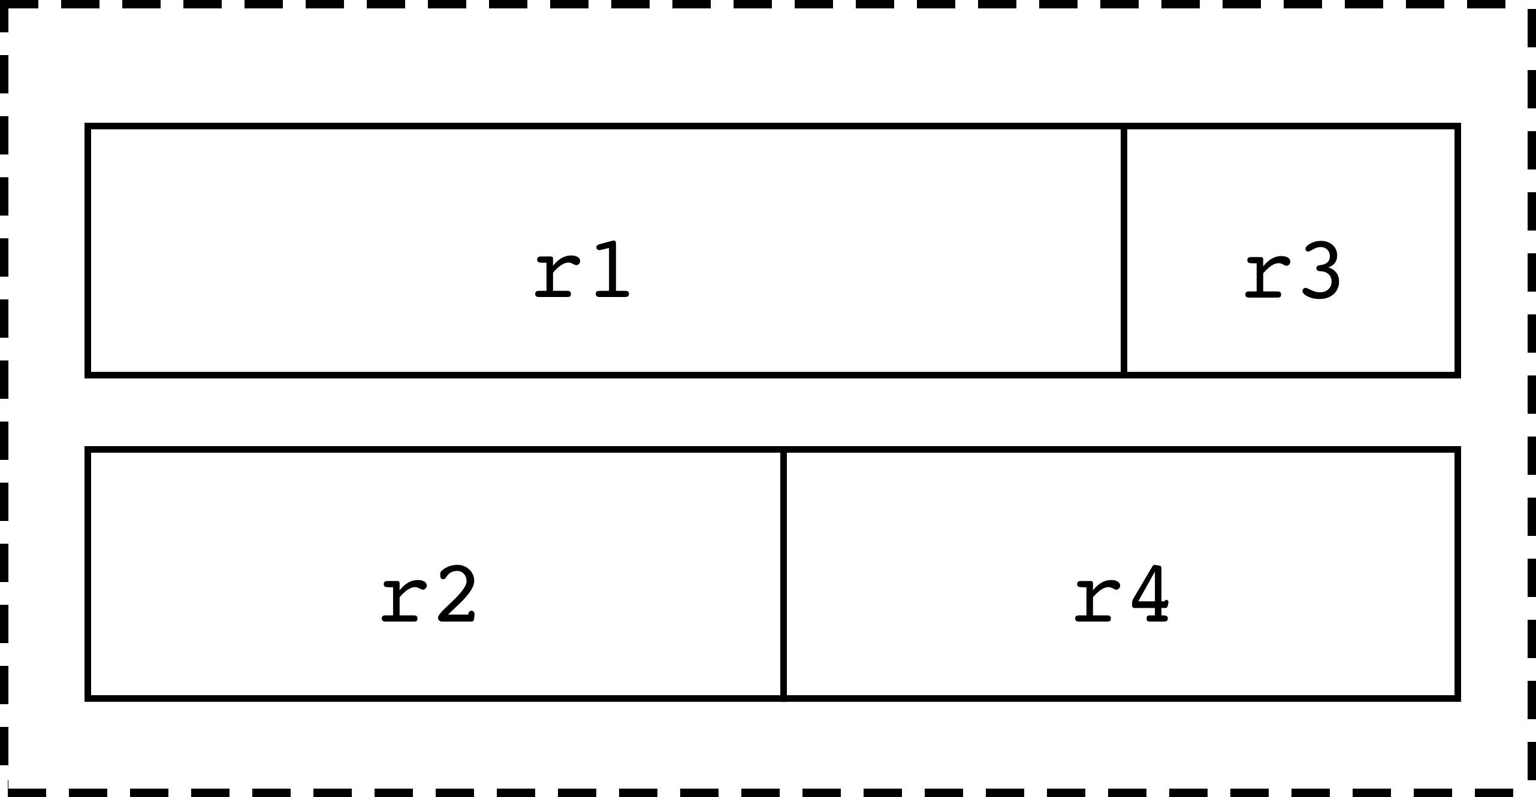







Our Proposal: CORF
Idea: Combining multiple register reads into a single physical read
Results:
IPC by 9%
RF dynamic energy by 17%
RF static energy by 52%

Slide 4
Outline
‌Background and Motivation
CORF: Coalescing Operand Register File
  Compile Time Operation
  Run Time Operation
  Limitation
CORF++: Re-architected RF
  Compile Time Operation
  Run Time Operation
Evaluation
Summary

Slide 5
Baseline Register File
128 KB RF per SM
  Split across 4 banks
  A bank is made up of 8 sub-banks, each 128 bits wide
  A full warp register can be striped using one entry of one bank
t0
t1
t2
t3
t4
t5
t6
t7
t28
t29
t30
t31
P0
P1
32-bits
.
.
GPU Register File Design
.
.
Bank 0
.
.
P255
128-bits
Sub-bank 0
Sub-bank 1
Sub-bank 7
GPU Register File Design
Do all values need full 32-bit width to be represented?

Slide 6
Prominence of Narrow-width Values
Register operand characteristic
72%
33%
65%
Can we pack multiple narrow-width values into a single physical register?

Slide 7
Register Packing
Co-locating multiple narrow-width registers in the same physical register [Ergin’04][Wang’17]
P1
r1
r2
r1
P1
r1
P2
r2
r3
P2
r2
P3
r3
r5
r4
P3
r3
P4
r4
P4
r4
40% saving!
P5
r5
P5
r5
Baseline RF
Packed RF
reduce the effective size of register file
Goal of register packing is to
  First fit policy is used at the allocation time
  Mapping is done using a Renaming Table logic
But, still each register read requires a separate physical register read
Can we combine multiple register reads required by an instruction?

Slide 8
Coalescing Opportunities
Let’s try to coalesce reads using simple register packing (with first fit policy)
Upper bound: Fraction of all dynamic instructions which:
  Contain two register source operands that are both narrow-width
  They fit together in a single register entry
First fit is weak in promoting coalescing; how to pack the right registers together?
69%
4%
Instructions with coalesce-able register reads
Let’s incorporate a compiler-guided register allocation policy to identify pairs of registers commonly read together

Slide 9
CORF: Overview
Register pairs are identified at compile time through static analysis.
  (r1, r3) as well as (r2, r4).
At run-time, common register pairs will be dynamically packed together, if possible.
  (r2, r4) in this example.
Kernel Binary
Profile Register Pairings
Common Pairs Identification
CORF RF
2
(r1, r3)
r1, r2
(r2, r4)
r1, r4
r1
----
r1
r4
r2
r4
8
7
10
r3
r2
r3
----
Compile time
Execution time

Slide 10
CORF: Compile Time Operation
Identifying exclusive common pairs
  Profiling the frequency of register pairs in order
  to build a Register Affinity Graph
  Remove edges of the registers that have more than
  one edge to identify exclusive common pairs
Passing compiler-assisted helps to the hardware
  Set of exclusive register pairs identified by the compiler are annotated in the executable’s preamble of a kernel
Profile Register Pairings
Common Pairs Identification
r1
2
r4
(r1, r3)
r1, r2
(r2, r4)
r1, r4
8
7
10
r2
r3
Compile time

Slide 11
CORF: Run Time Operation
During run time, CORF packs the identified register pairs into
the same physical register entry
  (r1, r3) do not fit in a single physical register
Coalescing opportunities are identified using the Renaming Table
  If the two source operands reside in the same physical register, then accesses are coalesced
CORF coalescing opportunities are limited to registers stored within the same physical register entry.
CORF RF
r1
----
r2
r4
r3
----
Execution time
What if a register is commonly accessed with two or more other registers?

Slide 12
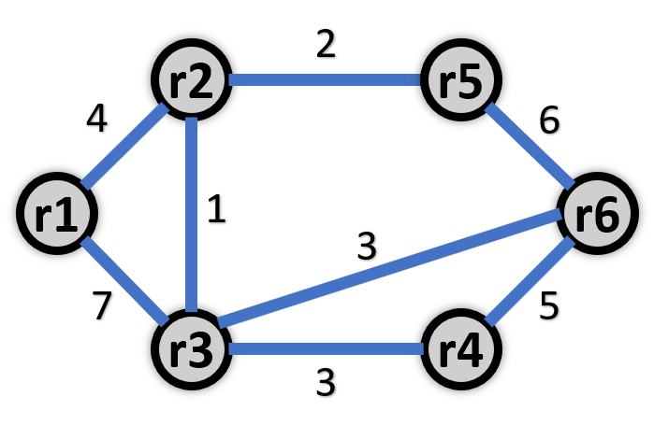
CORF++: Overview
Instead of identifying exclusive register pairs, compiler solves a variant of graph coloring problem to simplify the allocation to left or right-aligning assignment
During runtime, any left-aligned register is coalesce-able with any right-aligned register providing they don't overlap.
Kernel Binary
Register Affinity Graph
Alignment Identification
Coalescing-Aware RF
Left
Right
r1
----
r3
r1
r2
r4
r2
r4
r3
r5
r6
r5
r6
----
Compile time
Execution time
How to allocate registers to left/right RF slices for maximizing coalescing opportunities?
How to architect the RF to allow coalescing across different phys. registers?

Slide 13
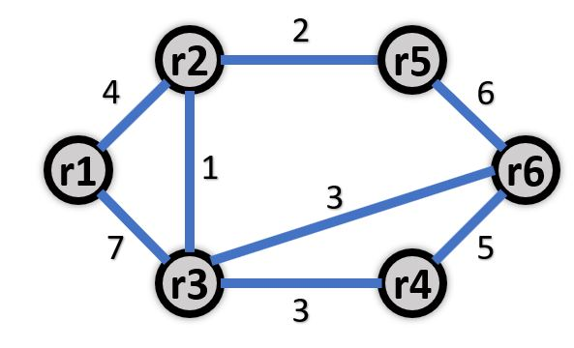
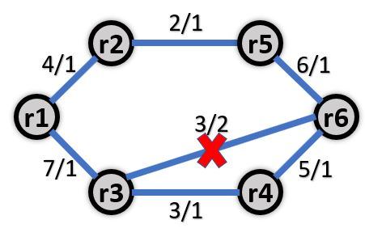
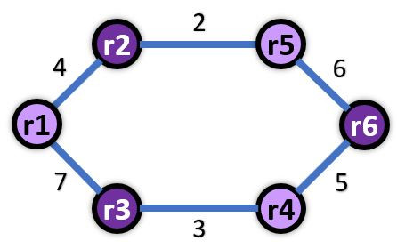
CORF++: Compiler Support
Optimal solution to remove the minimum number of edges of a graph to make it two-colorable is NP-hard
Any graph with no odd cycles (cycles made up of an odd number of edges) is 2-colorable
We developed the following heuristic to remove all odd cycles:
    Assign each edge a weight corresponding to its original weight, divided by the number of odd cycles that removing it would break
    Remove the edge with the minimum weight and update the weights
    Repeat until all odd cycles are eliminated

Slide 14
CORF++: Architecture Support
To support coalescing across different physical register entries, we need dual-addressable banks
Moreover, we need to changed register-to-bank mapping policy
  Details in the paper
Coalescing-Aware RF
r1
----
r3
P2
r4
r2
P3
r5
r6
----
Execution time
Address 1: P2
Subbank 0
Subbank 1
Subbank 2
Subbank 3
Subbank 4
Subbank 5
Subbank 6
Subbank 7
MUX
MUX
MUX
MUX
MUX
MUX
MUX
MUX
Address 2: P3

Slide 15
Coalesced Instructions
INT-intensive
FP-intensive
69%
48%
23%
4%
Fraction of coalesced instructions
CORF and CORF++ significantly increase the amount of coalescing opportunity

Slide 16
Performance Improvement
INT-intensive
FP-intensive
9%
4%
IPC improvement
CORF and CORF++ improve IPC by reducing the pressure on RF ports

Slide 17
RF Access Reduction—Dynamic Energy
23%
10%
Register file access reduction
CORF and CORF++ reduce RF accesses which gets translated to 8.5% and 17% dynamic energy reduction

Slide 18

Effective Size of RF—Static Energy
54%
35%
34%
Register file size reduction
Reduction in effective size of RF gets translated to 53% static energy reduction

Slide 19
Summary
Register file is a critical structure in GPUs
A lot of values do not require full-width register to be represented
We proposed CORF which combines multiple register reads into a single physical register read
CORF++ furtherly re-architects RF to take more advantage of register coalescing opportunities
Our technique improves IPC by 9% and reduces RF dynamic and static energy by 17% and 52%, respectively.

Slide 20
CORF: Coalescing Operand Register File for GPUs
Hodjat Asghari Esfeden
Farzad Khorasani
Hyeran Jeon
Daniel Wong
Nael Abu-Ghazaleh
The 24th International Conference on Architectural Support for Programming Languages and Operating Systems – ASPLOS 2019

Slide 21
RF Dynamic Energy

Slide 22
RF Static Energy
INT-intensive
FP-intensive
INT-intensive
FP-intensive

Slide 23
Methodology
Simulator:
  GPGPU-Sim modeling NVIDIA Fermi architecture
Workloads:
  Rodinia
  Parboil
  CUDA-SDK
  Tango
Notes:
I need to put more stuff here… A lot of white space…

Slide 24
CORF++: Illustrative Example
A
B
<L: r3, r5 | R: r2, r4>
C
<L: r3, r5 | R: r2, r4>
D
<L: r3, r5 | R: r2, r4>
E
<L: r3, r5 | R: r2, r4>
F
<L: r3, r5 | R: r2, r4>
SASS Code:
GLD r1, [0x80];
ISUB r2, r1, 0x7;
SHR r4, r1, 0x8;
LLD r3, [r4];
IADD r5, r2, r3;
IMUL r1, r4, r5;
ISUB r2, r3, r4;
GLD r1, [0x80];
ISUB r2, r1, 0x7;
IMUL r1, r4, r5;
ISUB r2, r3, r4
SHR r4, r1, 0x8;
LLD r3, [r4];
IADD r5, r2, r3;
Physical
Register
File
P0
r1
Physical
Register
File
P0
r1
Physical
Register
File
P0
r3
r1
Physical
Register
File
P0
r3
r1
Physical
Register
File
P0
r3
r1
P1
r2
P1
r2
P1
r2
P1
r2
P1
r2
P2
P2
r4
P2
r4
P2
r5
r4
P2
r5
r4

