Slide 1
RegMutex: Inter-Warp GPU Register Time-Sharing
Farzad Khorasani* Hodjat Asghari Esfeden Amin Farmahini-Farahani
Nuwan Jayasena Vivek Sarkar
*farkhor@gatech.edu
The 45th International Symposium on Computer Architecture - ISCA 2018

Slide 2
GPU Register File
The fastest and the most-expensive type of memory
To allow warp context-switching with minimal overhead, registers are:
Statically assigned
Exclusively dedicated
Largest on-chip resource to support up to 2048 resident threads
Accounts for a large fraction of chip area and power consumption
Picture from Nvidia Volta architecture whitepaper.

Slide 3
GPU Register File
Static assignment
A fixed number of registers per thread are requested throughout kernel execution
Exclusive allocation
Allocated physical registers cannot be used by other warps
Example from nvdisasm CUDA binary utility documentation
(https://docs.nvidia.com/cuda/cuda-binary-utilities/index.html#nvdisasm)
Notes:
Illustration on the right hand said shows the total fraction of registers used.

Slide 4
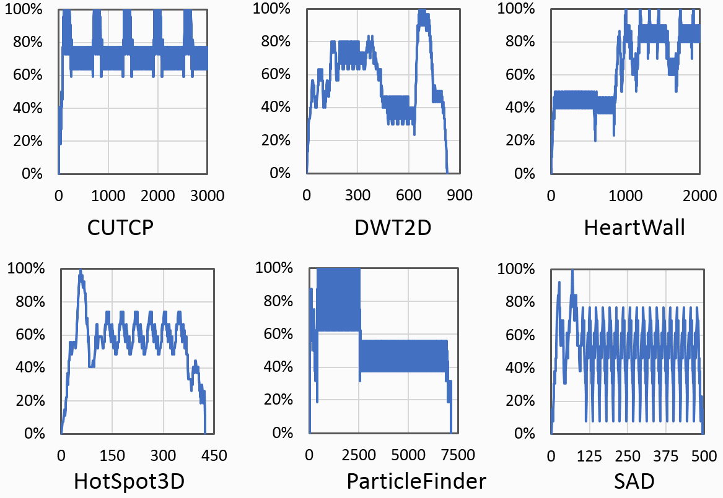
Static and Exclusive Register Allocation
Results in GPU register file underutilization
A large portion of physical registers are allocated but rarely used
X axis: the number of instructions executed by the thread
Y axis: the percentage of live registers with respect to allocated registers
The utilization of a sample thread’s allocated register set during kernel execution

Slide 5
Static and Exclusive Register Allocation
Problematic when occupancy is limited by register usage
Warp A starts execution
Warp A ends execution and warp B starts execution
Unused registers allocated to warp A
Unused registers allocated to warp B
Register Allocation
Time
Registers allocated to and used by warp A
Registers allocated to and used by warp B

Slide 6
Related Works
Register File Virtualization (MICRO 2015)
Implement a Register Renaming Table for Warp Registers
Resource sharing (HPDC 2016)
Warps race for one-time acquisition of shared resources
Zorua (MICRO 2016)
Virtualize on-chip resources and distribute them among warps on-demand
RegLess (MICRO 2017)
Remove register file and organize prefetching of thread-private variables

Slide 7
RegMutex: Main Idea
Register Mutual Exclusion: a compiler-architecture co-design
RegMutex shares registers between SM warps by time-multiplexing
Compiler marks regions of the kernel binary with high register consumption. Registers needed in such areas form extended register set
A shared register pool is designated out of register file upon kernel initiation
When program needs to work with extended set, it needs to be acquired from the shared pool
Think of it as communal register allocation

Slide 8
RF Utilization Visualization in RegMutex
Warp 0
Warp 2
Warp 3
Warp 0
Warp 2
Warp 1
Warp 4
Warp 1
Warp 3
Warp 4
Warp 6
Warp 5
Warp 5
Warp 7
Rt
Rt
Rt
Rt
Rt
Rt
Bs
Bs
Bs
Bs
Bs
Bs
Bs
Bs
Rt = Bs + Es
Es
Es
Es
Equal resources:
|Rt| * 6 = |Bs| * 8 + |SRP|
Shared Register Pool (SRP)
Default
RegMutex

Slide 9
RegMutex
Warp A starts execution
Warp A releases its extended register set
Warp A acquires its extended register set
Warp A ends execution
Shared pool for extended register set
Register Allocation
Wait
Warp B
base register set
Warp A
base register set
Warp B ends execution
Warp B starts execution
Warp B acquires its extended register set and resumes
Warp B releases its extended register set
Warp B tries to acquire its extended register set but stalls

Slide 10
RegMutex
Main contribution:
Higher kernel occupancy on a fixed resource budget
Sustaining approximately the same performance with a smaller RF
Main advantages compared to existing approaches:
Low hardware overhead by offloading the resource allocation to the compiler
Does not affect kernels that do not require RegMutex capabilities
Can be disabled by the compiler without side effects

Slide 11
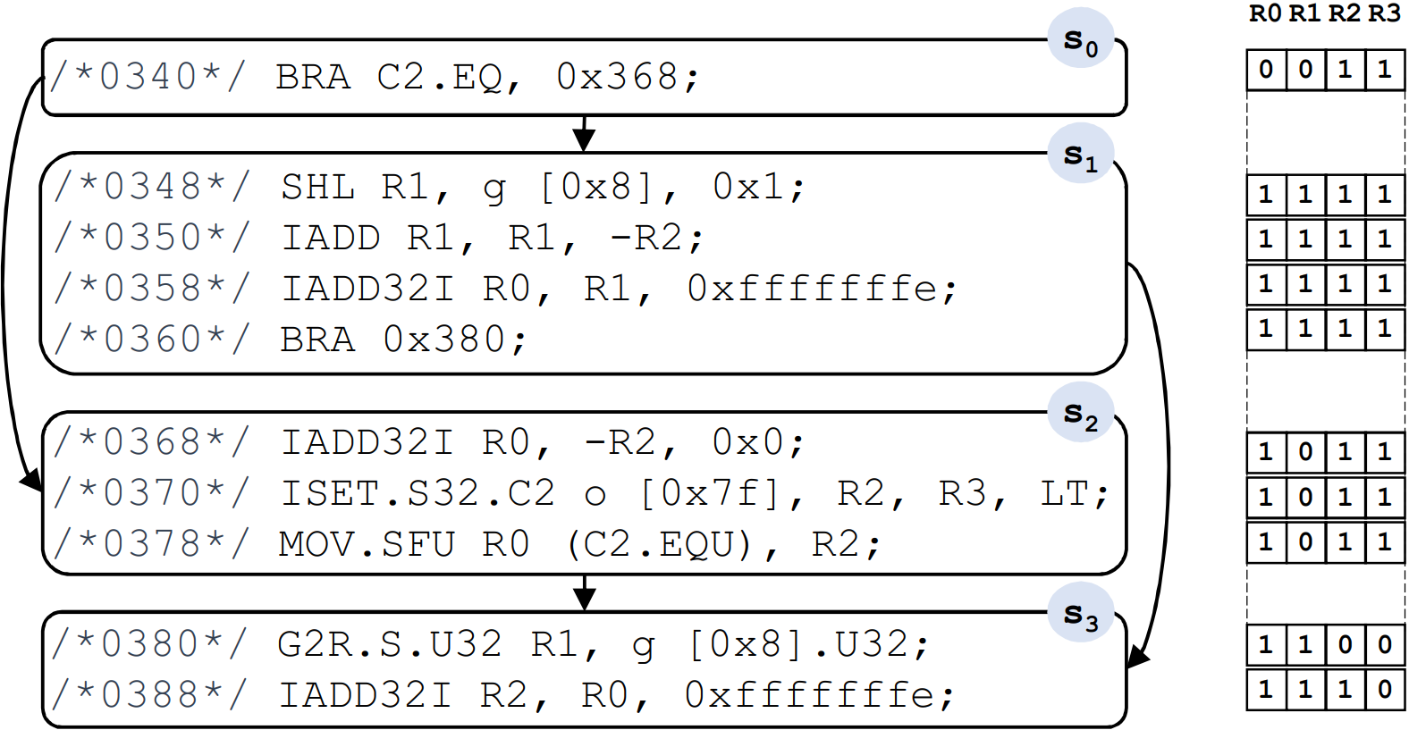
RegMutex: Compiler Side
1st step: register liveness analysis of the GPU assembly code to extract the register usage information

Slide 12
RegMutex: Compiler Side
2nd step: extended register set size determination
- Determine |Bs| and |Es|, the sizes of base and extended sets
3rd step: acquire/release primitive injection into the assembly code
4th step: architected register index compaction before and throughout the release state
- Allows keeping existing hardware for architected reg. to physical reg. mapping

Slide 13
RegMutex: Architecture Side
Scoreboard
ALU
FFetch
I-Cache
Decode
Issue
Operand
Collector
I-Buffer
MEM
Warp Status Bitmask
LUT
SRP Bitmask
N_{w}
N_{w}
N_{w}
ceil(log₂(N_{w}))

Slide 14
RegMutex: Architecture Side
To acquire Es:
Find an empty location in SRP Bitmask. Wait if there is no empty section
Write the location index into warp’s row in the Look-Up Table
Set warp status bitmask
SRP Bitmask
LUT
Warp Status Bitmask
3
1
2
LUT[W_{idx}]=loc
Set(W_{idx})
loc=FFZ(SRP)
Wait

Slide 15
RegMutex: Architecture Side
To release Es:
Unset the warp status bitmask
Find the warp-assigned SRP location from LUT
Unset the found location in SRP bitmask
Warp Status Bitmask
LUT
SRP Bitmask
1
2
3
Unset(W_{idx})
srpidx = LUT[W_{idx}]
Unset(srpidx)

Slide 16
Experimental Results: Kernel Occupancy Boost
GPGPU-Sim v 3.2.2 - GTX480 specifications with 15 SMs and 128 KB regs/SM
8 apps from Rodinia, Parboil, and Nvidia CUDA SDK
Compilation with NVCC 4.0, GCC 4.6 with -O3, and CC 1.3
Occupancy is limited by excessive reg usage
Average execution cycle reduction of 13%

Slide 17
Experimental Results: RF Size Reduction
GPGPU-Sim v 3.2.2 - GTX480 specifications with 15 SMs and 64 KB regs/SM
Another 8 apps from Rodinia, Parboil, and Nvidia CUDA SDK
Compilation with NVCC 4.0, GCC 4.6 with -O3, and CC 1.3
Occupancy is limited by excessive reg usage on the new arch. spec
Without RegMutex: 23% execution cycle increase
With RegMutex: 9 % execution cycle increase

Slide 18
Experimental Results: Performance Comparison
GPGPU-Sim v 3.2.2 - GTX480 specifications with 15 SMs and 128 KB regs/SM
8 apps from Rodinia, Parboil, and Nvidia CUDA SDK
Compilation with NVCC 4.0, GCC 4.6 with -O3, and CC 1.3
OWF: Owner Warp First [HPDC’16]
RFV: Register File Virt. [MICRO’15]
On average: OWF 1.9%, RFV 16.2%, RegMutex 12.8%
RFV demands 31 kilobits while RegMutex needs 384 bits (~81x)

Slide 19
Summary
Static and exclusive register allocation on GPUs wastes resources
RegMutex offers a synergistic compiler-architecture technique to improve GPU register utilization
Marks regions of the high register consumption and takes a communal approach on allocating physical registers for such regions
Improves occupancy when it is limited by register usage
Provides application resilience with smaller RF size
Lower hardware implementation complexity compared to counterparts
Reduces execution cycles by up to 23%

Slide 20
RegMutex: Inter-Warp GPU Register Time-Sharing
Farzad Khorasani* Hodjat Asghari Esfeden Amin Farmahini-Farahani
Nuwan Jayasena Vivek Sarkar
*farkhor@gatech.edu
The 45th International Symposium on Computer Architecture - ISCA 2018

Slide 21
Disclaimer & Attribution
The information presented in this document is for informational purposes only and may contain technical inaccuracies, omissions and typographical errors.
The information contained herein is subject to change and may be rendered inaccurate for many reasons, including but not limited to product and roadmap changes, component and motherboard version changes, new model and/or product releases, product differences between differing manufacturers, software changes, BIOS flashes, firmware upgrades, or the like. AMD assumes no obligation to update or otherwise correct or revise this information. However, AMD reserves the right to revise this information and to make changes from time to time to the content hereof without obligation of AMD to notify any person of such revisions or changes.
AMD MAKES NO REPRESENTATIONS OR WARRANTIES WITH RESPECT TO THE CONTENTS HEREOF AND ASSUMES NO RESPONSIBILITY FOR ANY INACCURACIES, ERRORS OR OMISSIONS THAT MAY APPEAR IN THIS INFORMATION.
AMD SPECIFICALLY DISCLAIMS ANY IMPLIED WARRANTIES OF MERCHANTABILITY OR FITNESS FOR ANY PARTICULAR PURPOSE. IN NO EVENT WILL AMD BE LIABLE TO ANY PERSON FOR ANY DIRECT, INDIRECT, SPECIAL OR OTHER CONSEQUENTIAL DAMAGES ARISING FROM THE USE OF ANY INFORMATION CONTAINED HEREIN, EVEN IF AMD IS EXPRESSLY ADVISED OF THE POSSIBILITY OF SUCH DAMAGES.
ATTRIBUTION
© 2018 Advanced Micro Devices, Inc. All rights reserved. AMD, the AMD Arrow logo and combinations thereof are trademarks of Advanced Micro Devices, Inc. in the United States and/or other jurisdictions. Other names are for informational purposes only and may be trademarks of their respective owners.

