Slide 1
In-Register Parameter Caching for Dynamic Neural Nets with Virtual Persistent Processor Specialization
Farzad Khorasani Hodjat Asghari Esfeden Nael Abu-Ghazaleh Vivek Sarkar
The 51st Annual IEEE/ACM International Symposium on Microarchitecture - MICRO 2018

Slide 2
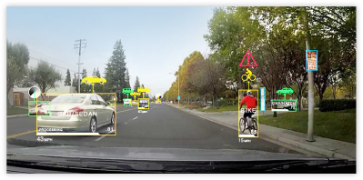
neural netWORKs & deep learning
- A branch of Machine Learning
- Solves complex tasks using lots of data
- No need to hand-engineer features
Speech recognition
Computer vision
Machine translation
LeNet (Yann LeCun, 1988) as an example
1

Slide 3
neural netWORKs: REPRESENTED AS COMPUTATION GRAPH
Model Parameters
W₁
b₁
W₂
b₂
Input
x
+
relu
x
+
softmax
loss
Training:
for n iterations
for i training input batch
forward-pass
backward-pass
update parameters
forward-pass:
for each node
compute output tensor content
backward-pass:
for each node
compute the gradient
update parameters:
for each parameter node
apply its gradient
2

Slide 4
Dynamic neural nets
- Although the set of model parameters do not change, there is no fixed architecture.
- For every input, the shape of the computation graph may be different.
W₁
b₁
W₂
b₂
in1
x
+
relu
x
+
softmax
loss
W₁
b₁
W₂
b₂
in2
x
+
softmax
loss
W₂
b₂
W₁
b₁
in3
x
+
tanh
x
+
softmax
loss
3

Slide 5
Dynamic neural net Example
Tree-Structured LSTM Sentiment Analyzer (Tai et al., in ACL 2015)
LSTM
W_{f,i,c,o}
LSTM
W_{f,i,c,o}
LSTM
LSTM
W_{f,i,c,o}
W_{f,i,c,o}
LSTM
LSTM
LSTM
LSTM
LSTM
W_{f,i,c,o}
W_{f,i,c,o}
W_{f,i,c,o}
W_{f,i,c,o}
W_{f,i,c,o}
Broken
City
lacks
the
thrill
4

Slide 6
Persistent rnn: On-chip parameter persistency
In RNNs, cache recurrent weights on the chip (Diamos et al., in ICML 2016).
Avoid reloading them from DRAM again and again upon every visit.
Use collective register file of all SMs to hold the parameter matrices.
out_{t}
out_{t+1}
out_{t+2}
W
x
V
W
x
V
W
x
V
x
+
x
+
x
+
U
x
U
x
U
x
in_{t}
in_{t+1}
in_{t+2}
5

Slide 7
On-chip parameter persistency: The challenge
Persistent RNN requires operations in the computation graph to be pre-determined.
For instance, an input vector is always first multiplied by U, then always added by the multiplication result of state from previous round and W, … .
Since register file is invalidated upon kernel termination, the set of operations in-between weight matrix visits have to be within the same kernel.
Static indexing of registers in GPU kernel binary (no register renaming capability) is the other challenge.
We cannot have this assumption in dynamic nets!
An example piece of SASS (GPU binary) code.
6

Slide 8
On-chip parameter persistency for dynamic nets
7

Slide 9
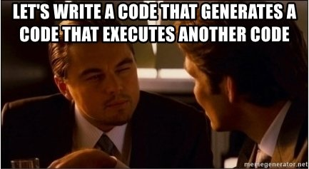
On-chip parameter persistency for dynamic nets
8

Slide 10
Our solution
a code that generates a kernel code that executes a script code
On top of DyNet framework in C++
CUDA kernel in CUDA C++ for forward-backward propagation
A CISC-like op code encoding execution procedure for a computation graph
One-time JIT compilation
For every input batch
Has in-register caching mechanisms for 2D model parameters
9

Slide 11
Our solution: virtual persistent processor specialization
a. One-time Kernel Preparation Procedure
User Inputs
Model Parameters
Parameter Routine Generation
Parameter Caching & Operation Routines
NVRTC-based
JIT Kernel Construction
Forward & Backward Kernel
Script Interpretation & Execution Routines
Parameter Distribution Information
Script Generation via Graph Traversal
Forward Propagation
&
Backward Propagation
Depth-based Operation Grouping
Forward & Backward Execution Script for Virtual Processors
b. Kernel Launch Procedure for Every Training Batch
10

Slide 12
Forward-backward kernel jitting
a. One-time Kernel Preparation Procedure
This phase assembles the CUDA C++ source code for the forward-backward kernel.
The source will be given to Nvidia Runtime Compiler (NVRTC) to construct a kernel.
This kernel will be solely responsible for forward-backward prop and parameter update.
Model Parameters
Parameter Routine Generation
Parameter Caching & Operation Routines
NVRTC-based
JIT Kernel Construction
Forward & Backward Kernel
Script Interpretation & Execution Routines
Parameter Distribution Information
11

Slide 13
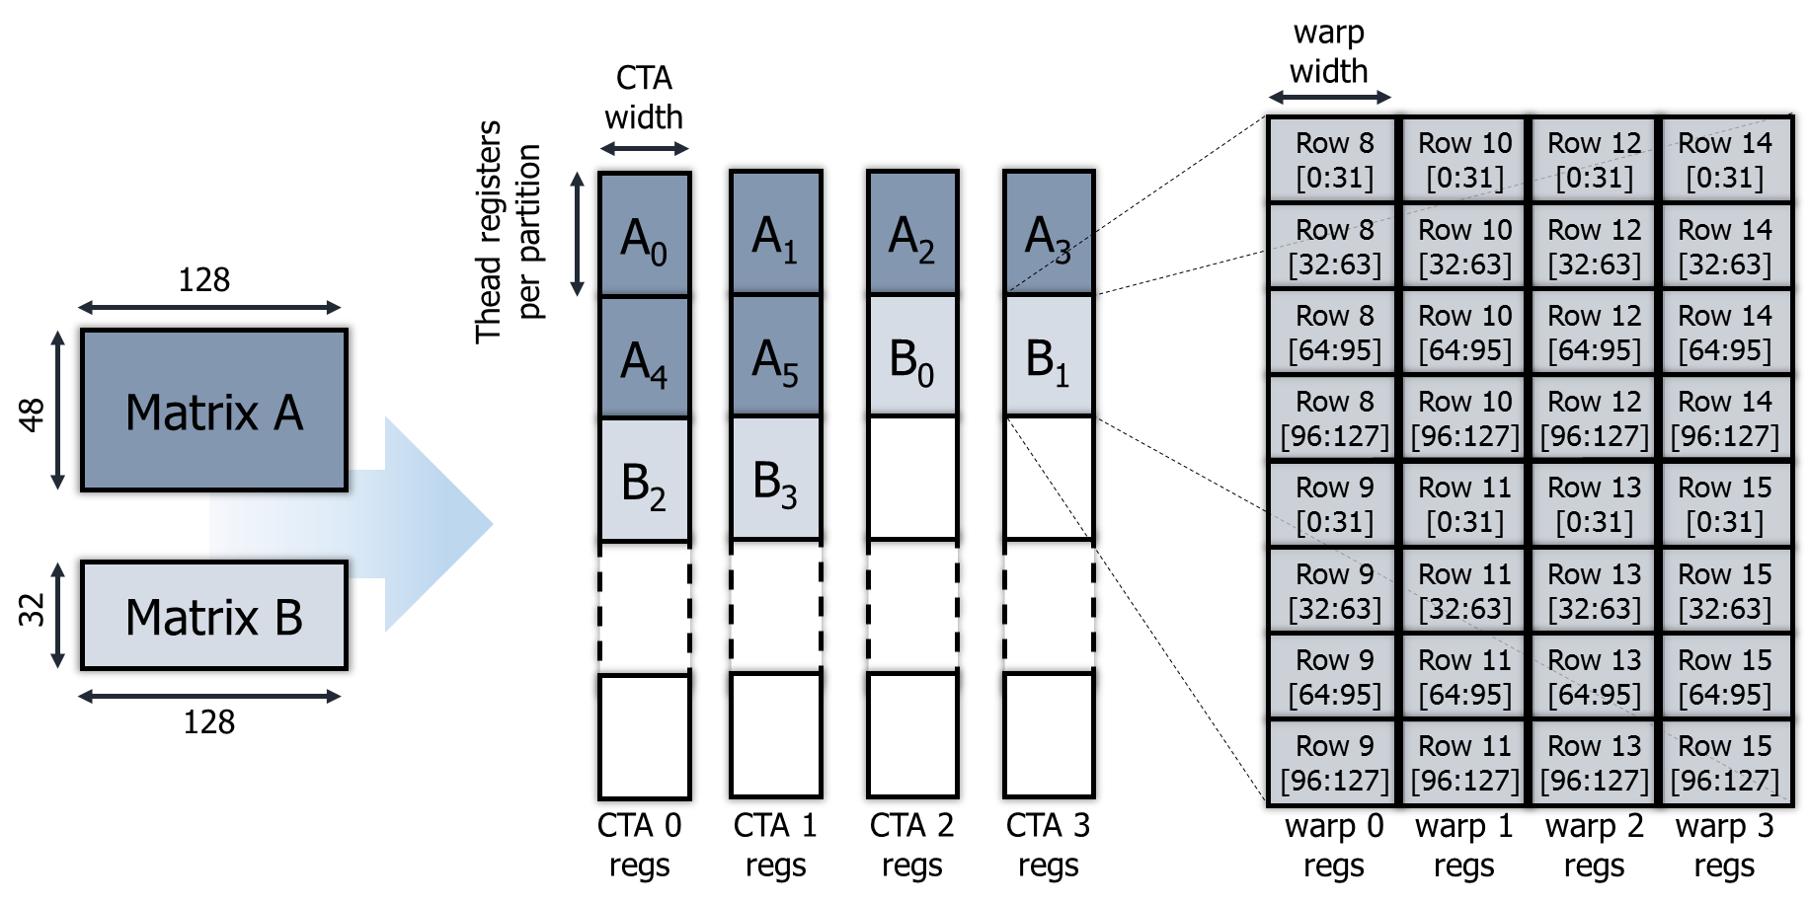
Forward-backward kernel jitting: weight matrix distribution
Assigning 2D parameters of the model to virtual register partitions
Round-robin assignment of matrix pieces to thread-block partitions
Each piece of matrix contains multiple rows.
12
Notes:
This form of assignment aims to reduce inter-thread-block load imbalance.
Hoping NVCC creates similar codes for pieces at one level.

Slide 14
Forward-backward kernel jitting: parameter handling Routines
In-register device-side templated CUDA functions:
Matrix vector multiplication
Transposed-matrix vector multiplication
Vector-vector outer-product
Parameter load from master copy in DRAM
In-register gradient matrix initialization to zero
Gradient application to the master copy in DRAM
13

Slide 15
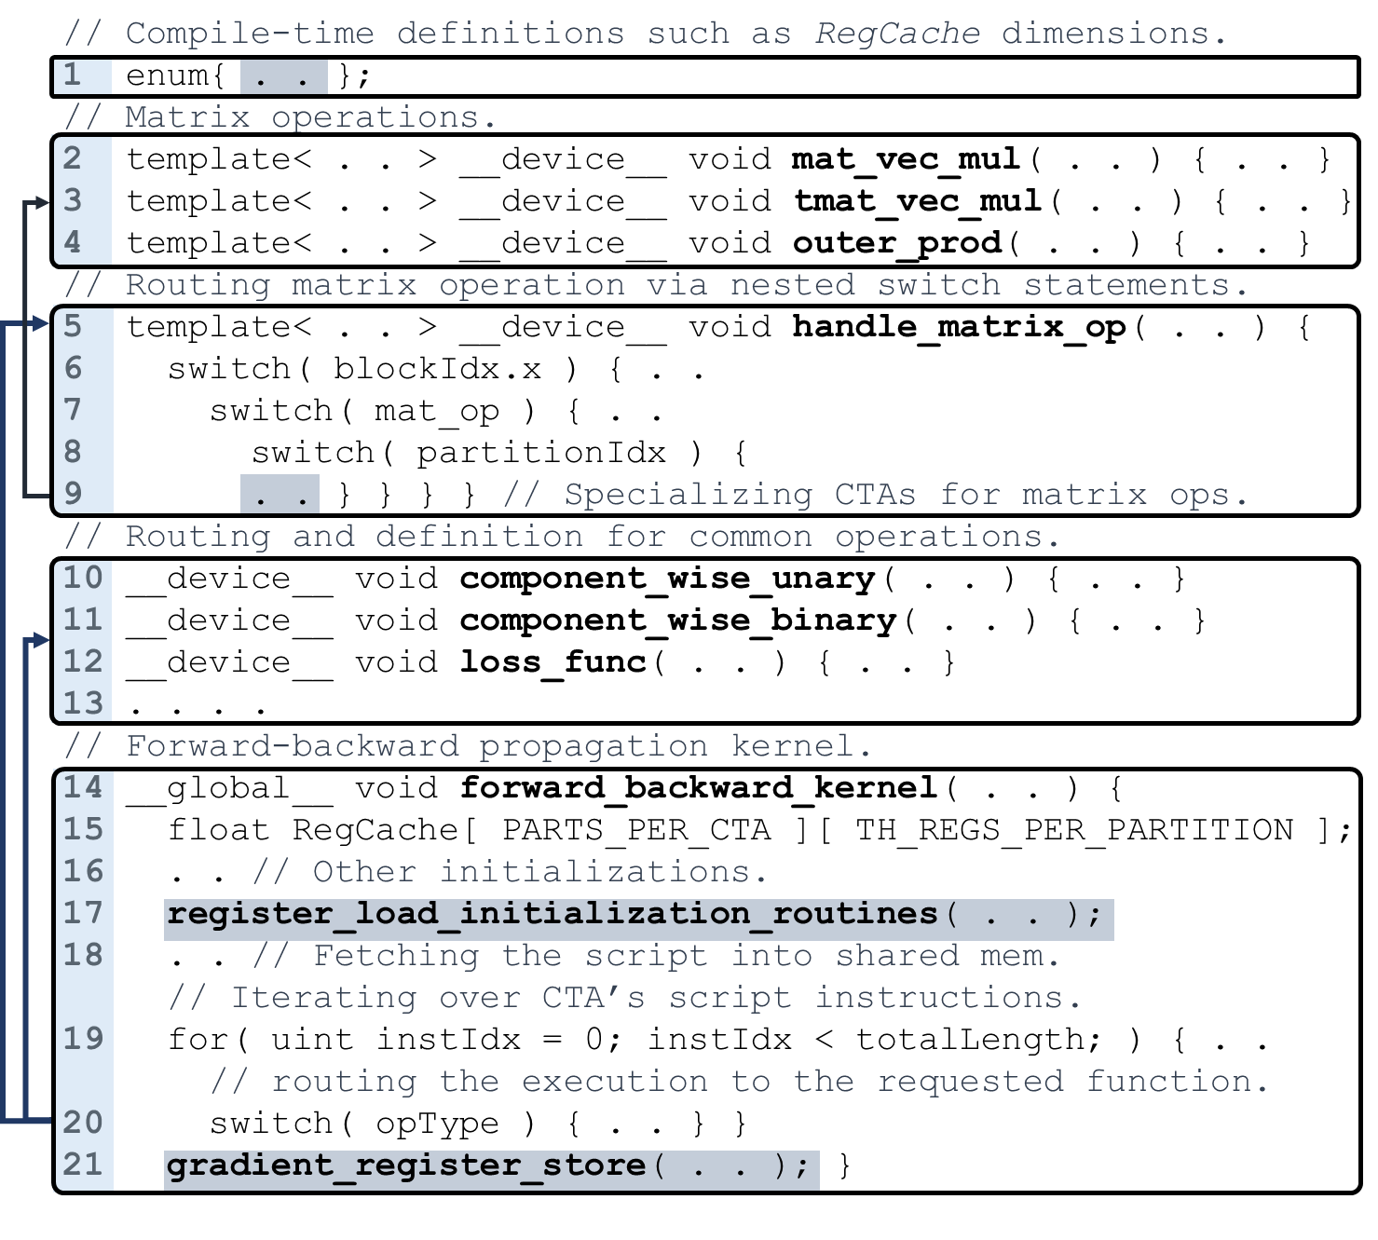
Kernel Source Structure
14
Notes:
Highlighted parts are specialized at runtime.

Slide 16
Gpu script generation and execution
Parameter Distribution Information
Forward & Backward Kernel
This phase provides a driving mechanism for the produced kernel.
Each thread-block is treated as a virtual vector processor that interprets and executes instructions supplied within its assigned script.
This strategy enables portability as it makes no assumption about the shape of the computation graph.
Script Generation via Graph Traversal
Forward Propagation
&
Backward Propagation
Depth-based Operation Grouping
Forward & Backward Execution Script for Virtual Processors
b. Kernel Launch Procedure for Every Training Batch
17

Slide 17
Gpu script generation and execution: script generation
Sort the nodes based on their maximum depth from the root nodes.
Gives a correct total order of nodes.
Parallelism between nodes within a level can be exploited.
Traverse the computation graph level by level.
For every visited node, encode the instruction for a CISC-like virtual vector processor.
Try to balance the load across thread-blocks.
15

Slide 18
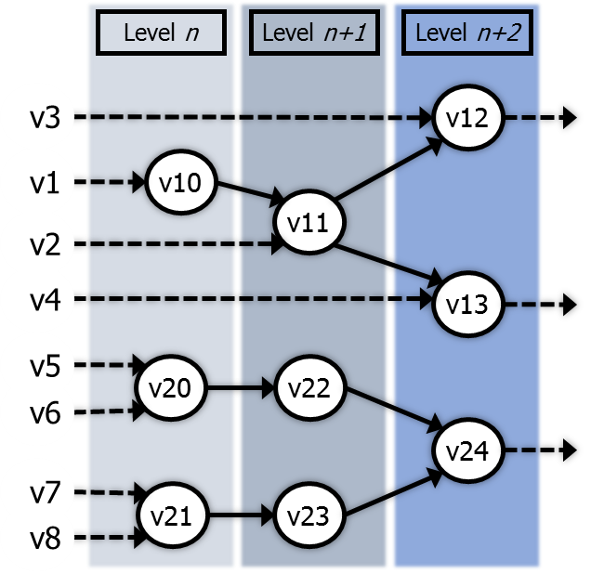
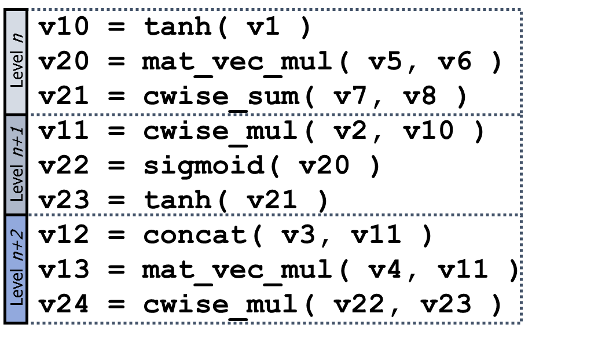
Gpu script generation and execution: script generation
16
Notes:
X axis in the last figure does not represent time.
Resembling TensorFlow-Fold (Looks et al.). The main difference is that … .
Each operand contains a 4-byte-long address to its tensor content in DRAM.
When done with instructions at level L, thread-blocks will be given signal instruction on a barrier.
Before executing the instructions at level L+1, thread-blocks will be given wait instruction on that barrier.
CISC vs. RISC:
If we were to virtualize CTAs as RISC processors instead of CISC, we would have to explicitly control the intermediate resources during the scheduling. For example, for a component-wise add, we would need to specify the on-chip memory and location the two input operands for the operation have to be fetched into. We would also need to specify where the result of the operation will be saved. Such a resource management introduces runtime overheads for the host during the training and negatively impacts the training throughput. On the contrary, a CISC abstraction for CTAs offloads resource management to NVCC and handles it at the kernel compiletime. Plus, the overall number of neural network operation types the kernel needs to support is limited, which does not provide an incentive for paying RISC abstraction cost.

Slide 19
Gpu script generation and execution: script execution
Threads within a thread-block fetch a chunk of instructions into TB’s shared memory.
Threads iterate over the instructions one by one.
The first element (32 bits) of an instruction encodes the operation type and output tensor length.
Based on the operation type of the instruction, the execution flow is routed to the appropriate function.
17

Slide 20
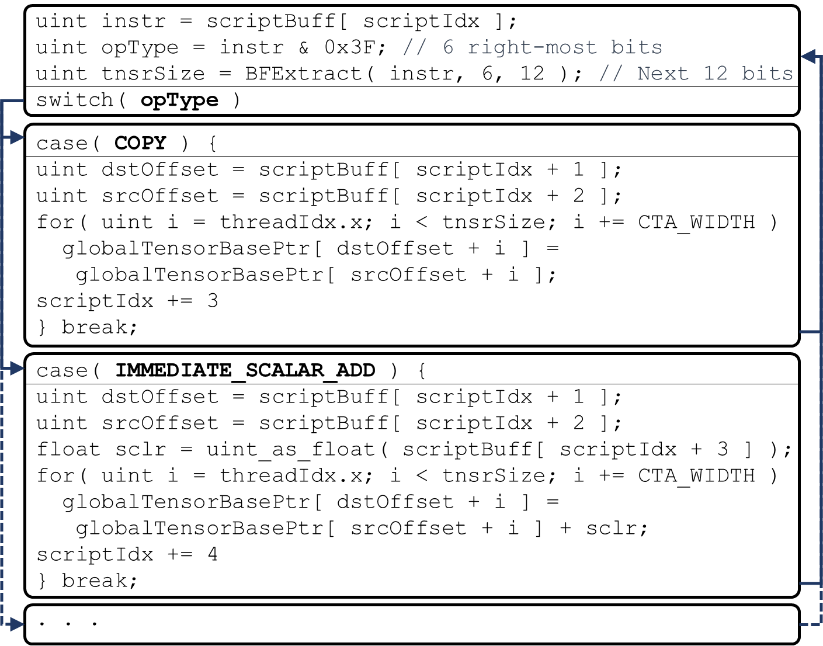
Gpu script generation and execution: 2. script execution
A fragment of the content of the virtual processor’s script interpretation loop
18

Slide 21
kernel execution asynchrony w.r.t. host
The execution of a forward-backward kernel is independent of the operations in the next batch.
We make the GPU kernel execute concurrently with scheduling and script construction for the next batch performed by the CPU.
This covers the majority of either GPU kernel execution time or CPU scheduling time.
19

Slide 22
Packaging as a library
This solution is automated as a C++ library.
The user interacts with our implementation using 3 calls:
1. Definition of the main object.
- JITs the kernel using model parameters behind the scene.
2. Forward and backward propagation on the given batch of inputs.
- Returns the calculated loss for the previous round.
3. Waiting until the operations on the GPU are finished.
- Returns the latest calculated loss.
vpps::handle hndl( model );
float staleLoss = hndl.forward_and_backward( model, cg, lossExpr );
float latestLoss = hndl.sync_get_latest_loss();
20

Slide 23
Evaluations against DyNet with on-the-fly batching (Neubig et al., in NIPS 2017)
Environment:
- Nvidia Titan V (Volta architecture, 80 SMs each 256 KB of reg. file), Intel Xeon ES-1650 v2 @ 3.5 GHz, PCIe 3.0 16x
- CentOS 7.4, GCC 4.9.3, CUDA 9.1
- Word vector length and hidden layer length are 256 in all examples. Training sets are WikiNER English Corpus (Nothman et al., 2012) and Stanford Sentiment Treebank (Socher et al., 2013).
Bi-directional LSTM Sequence Tagger
(Huang et al., 2015)
Bi-directional LSTM Sequence Tagger w/ Char. Feature
(Neubig et al., 2017)
Tree-Structured LSTM Sentiment Analyzer
(Tai et al., 2015)
21

Slide 24
VPPS Execution Time breakdown for tree-structured lstm
22

Slide 25
summary
Having parameter persistency in dynamic neural nets is challenging.
Persistent parameters necessitate precise declaration of the order of operations.
Dynamic nets do not guarantee a fixed shape.
VPPS: packaged as a C++ library that breaks the curse of dynamicity using an in-kernel interpreter. Our solution has two main parts.
The 1st part JIT compiles a forward-backward prop CUDA kernel.
The kernel caches the model parameters inside registers.
The kernel is constructed only once for the specified model.
The 2nd part encodes the operations within the computation graph and passes them to the CTA’s virtualized as CISC-like vector processors.
Within the kernel, instructions are decoded and executed as guided.
This part is done for every input batch of computation graphs.
23

Slide 26
In-Register Parameter Caching for Dynamic Neural Nets with Virtual Persistent Processor Specialization
Farzad Khorasani Hodjat Asghari Esfeden Nael Abu-Ghazaleh Vivek Sarkar
a. One-time Kernel Preparation Procedure
Model Parameters
Parameter Routine Generation
Parameter Caching & Operation Routines
NVRTC-based
JIT Kernel Construction
Forward & Backward Kernel
Script Interpretation & Execution Routines
Parameter Distribution Information
Depth-based Operation Grouping
Script Generation via Graph Traversal
Forward Propagation
&
Backward Propagation
Forward & Backward Execution Script
b. Kernel Launch Procedure for Every Training Batch
The 51st Annual IEEE/ACM International Symposium on Microarchitecture - MICRO 2018

Slide 27
ADVOCATING SMALL BATCHES
http://axon.cs.byu.edu/papers/Wilson.nn03.batch.pdf

Slide 28
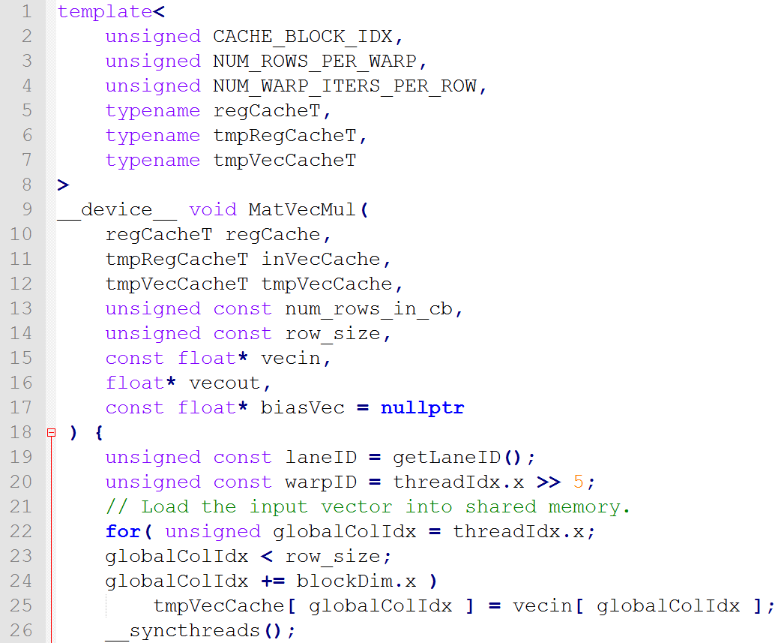
Forward-backward kernel jitting: kernel routine example
Source for in-register matrix multiplication with a given vector (1/2)

Slide 29
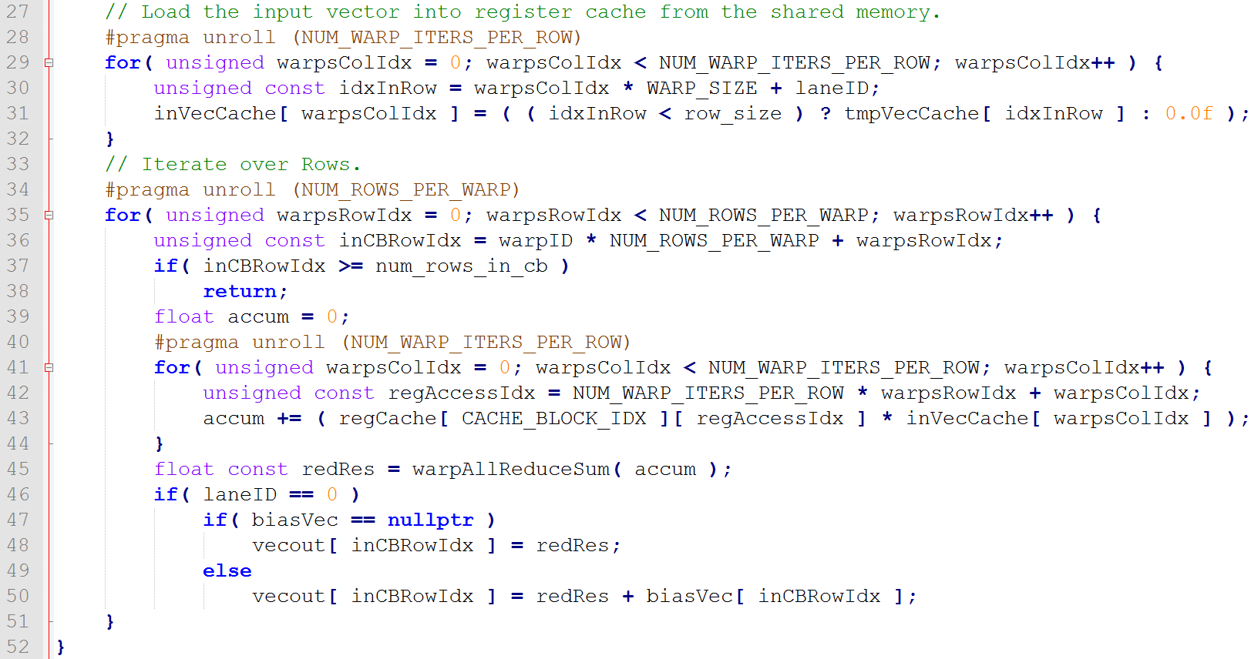
Forward-backward kernel jitting: kernel routine example
Source for in-register matrix multiplication with a given vector (2/2)

